Slide 1
ENES Milestone 1
Team STS (Sulfur Tungsten Silver)

Slide 2
Team Roster
Isaac Lee (The neutralizer)
Kenneth Daniel (Canned denial)
Michael Tao (Chairman Tao)
John Murdock (John Cena)
Eli Winton (Wins a ton)
Spencer Mical (One man army)
Stephen Waak (Woah, OK)

Slide 3
Mission objectives
Chemical Team:
Base Objectives:
Navigate to within 250 mm of the polluted freshwater pool
Measure the pH level of the pool
Transmit to command the pH level to within 0.3 units
Advanced Objectives:
Collect a 10 – 15 ml sample of the polluted water prior to neutralization
Neutralize the pool by returning the pH level to the range of 6 - 8 and transmit to command the final pH level

Slide 4
Team Structure
Project Leader: Michael Tao
Subgroups:
Mechanical : Isaac Lee
CAD: Kenneth Daniel
Electrical: John Murdock
Programming: Michael Tao
Meeting arrangements:
After class in JMP on Thursday
Otherwise, Hornbake or McKeldin

Slide 5
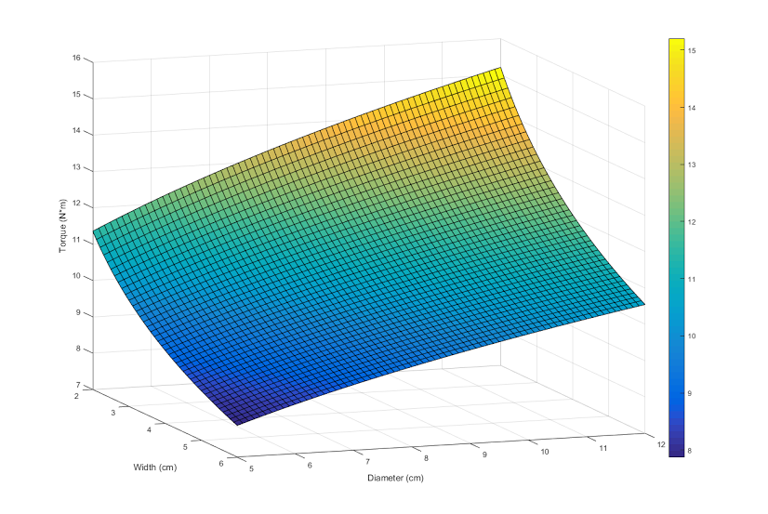
Design Concepts - Structure
4x4 design without suspension
Wheel width and diameter is being determined with respect to desired torque
Designing base for maximum size (350mm x 350mm)
Wooden base platform, 3d printed support

Slide 6
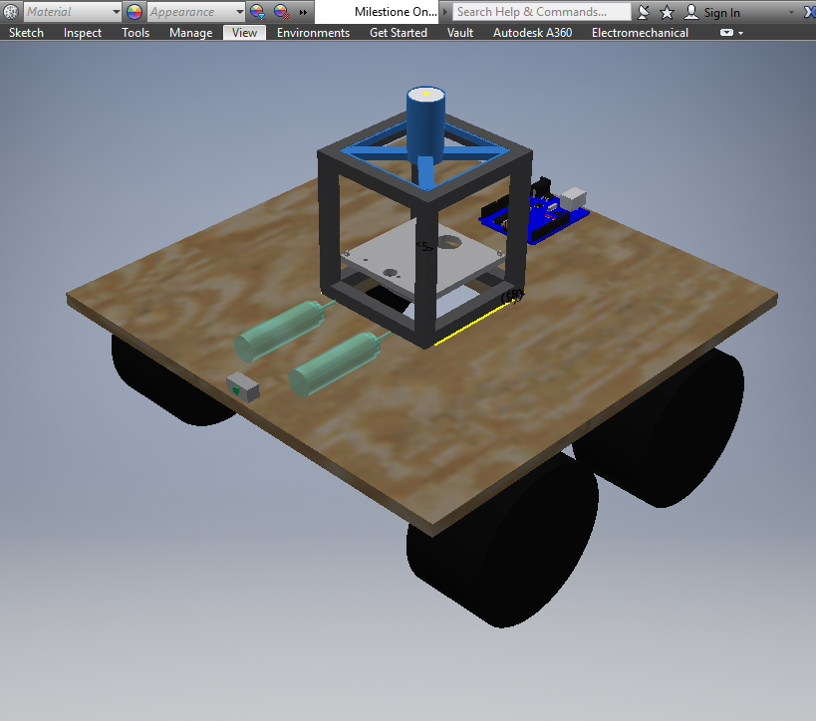
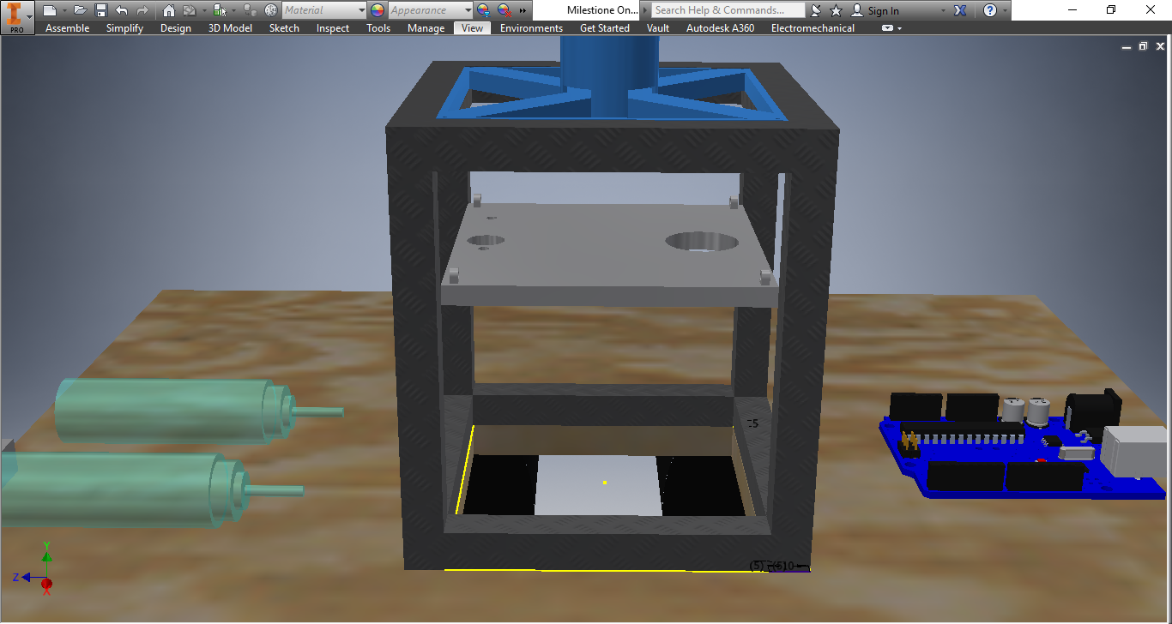
Design Concepts - Structure

Slide 7

Design Concepts - Mobility
Torque required in one rear wheel $τ=TE∙r$ $TE=C_{RR}∙F_{N}$ $C_{RR}={[3.33\frac{{cm}^{3}}{N}∙\frac{F_{N}}{w∙d^{2}}]}^{1/3}$
$$F_{N}=\frac{lmg\cos{θ}+hmg\sin{θ}}{4l}$$ r = wheel radius w = wheel width d = wheel diameter h = height of center of mass m = mass of OSV g = acceleration due to gravity ϴ = angle of inclination l = horizontal distance from contact point to center of mass

Slide 8

Design Concepts - Mobility
Using assumed values, r = 6.4cm w = 6cm d = 12.8cm h = 10cm m = 2.5kg g = 9.8$\frac{m}{s^{2}}$ 30° < ϴ < 40° l = 11.1cm $15.54 N∙cm<τ<15.99 N∙cm$ Minimum torque required for rear wheel rotation up an incline

Slide 9

Design Concepts – Avoiding The Dig
$$0.3F_{N}<TE<0.7F_{N}$$
$$0.3F_{N}∙r<τ<0.7F_{N}∙r$$
The limiting scenario would be at 0°
Using previous assumptions,
$$11.76 N∙cm<τ<27.44 N∙cm$$
Torque range required to not dig sand at 0°
$$15.99 N∙cm<τ<27.44 N∙cm$$
Torque range required to move up 40° inclines but not dig sand at 0°

Slide 10
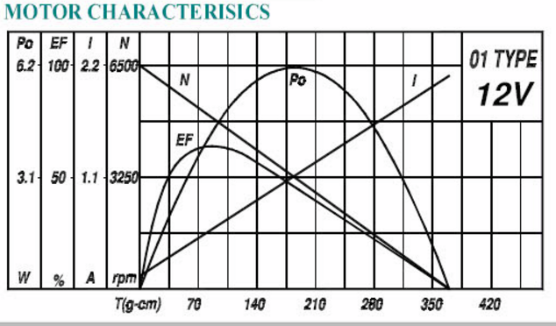

Design Concepts - Mobility
Based on our calculations of our range of $τ$, we have found 2 motors that fit our needs, both of the same form factor but with a different transmission
Both are planetary

Slide 11
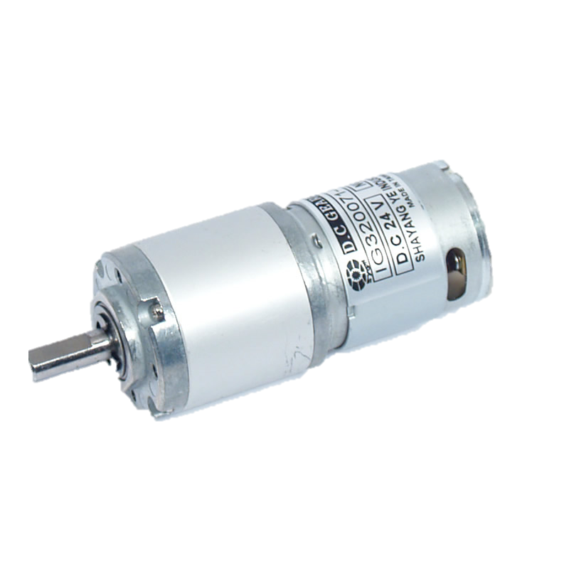
Design Concepts - Mobility
Torque: 45.08 N*cm
RPM: 53
Gear ratio: 1:100
Voltage: 12V
Max I draw: 530mA
Mass: 190g
Torque: 22.54 N*cm
RPM: 104
Gear ratio: 1:51
Voltage: 12V
Max I draw: 530mA
Mass: 190g

Slide 12
Design Concepts - Power
At maximum power, both of the motor choices will draw 530mA, so max current of 4 motors is 2.12A
Assuming the other systems draw 100mA, we have a total current draw of 2.22A
If we want a run time of 1 hour, we need a battery at 12V with a capacity of at least 2.22Ah

Slide 13
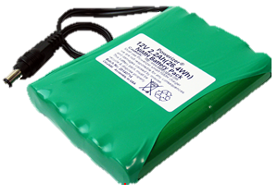
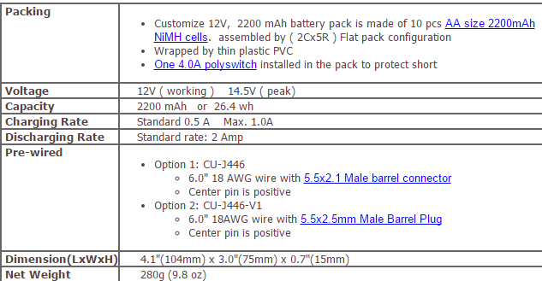
Design Concepts - Power
12 V 2200mAh battery with built in short circuit protection

Slide 14
Design Concepts – Mission performance
Platform driven directly over pool to perform mission objectives
pH probe on platform to be lowered into pool
Motor driven syringe to obtain sample
Motor driven syringe to inject neutralizer solution
Electric submersible pump to agitate solution
Closed feedback loop to neutralize solution to pH 7

Slide 15
Design Concepts - Navigation
Differential drive with the 4x4 motors
Using an array of ultrasonic sensors to locate obstacles
Contact sensors or color sensors underneath the OSV to detect the pool of water

Slide 16
Gantt chart

Slide 17
Anticipated problems
Problems
Inability to focus on task during meetings
Individual tasks not being completed by deadline
Electronics malfunctioning (Releasing magic smoke / mechanical failure)
Solutions
Create defined goals for each meeting
Enact consequences for failing to meet deadlines (Voluntary sponsored pizza dinner)
For cheaper parts, always buy an extra. Have someone else check wiring before powering on

Slide 18
Anticipated problems
Problems
Member unable to contribute due external reasons
Unequal work distribution
Solutions
Redistribute tasks to best ability
Discuss how work could be divided evenly but still adhere to standards

